Slide 1

Notencrypt
Notencrypt sees all, Knows all !
DEVESH KUMAR BOBY DUBEY UTKARSH KUMAR

Slide 2



Meet the TEAM: Hash-Zeeno
Devesh Kumar
Utkarsh Kumar
Boby Dubey

Slide 3
Is your Data secure? Because Privacy matters
A total of 310,855,487 accounts were leaked in 2022 – a third of the 959,327,963 occurrences seen in 2021. Year-over-year breach rates were 67.6% lower in 2022 than in 2021. Moreover, 10 accounts were leaked every second last year, as opposed to 30 accounts in 2021
Is Data Safety your Priority?
Is Privacy a
Human Right?
Why is your Data important for your Business?

Slide 4
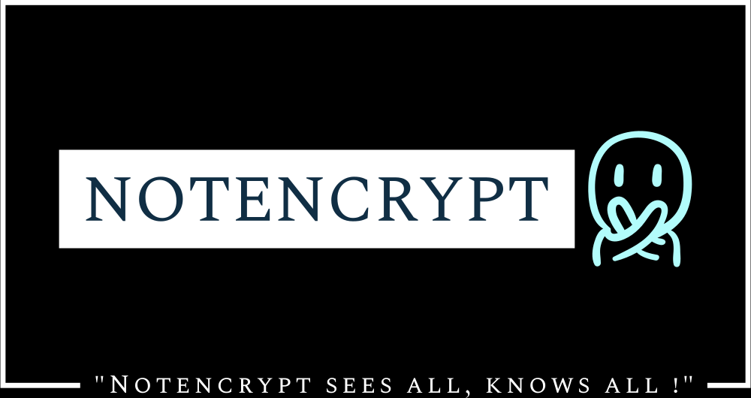
Problem Statement
In today’s digital age, the need for encryption in data has become increasingly important due to the following reasons:
Data Security: The amount of data being generated and transmitted over the internet is massive.
Privacy: With the increasing use of online services and social media, individual privacy has become a major concern.
Compliance: Many organizations are required by law to encrypt certain types of data. For example, the Health Insurance Portability and Accountability Act (HIPAA) requires healthcare organizations to encrypt patient data.
Reputation: If sensitive data is stolen or compromised, it can result in a loss of trust and reputation for an organization.

Slide 5
Society relies on secure encryption
Secure encrypted communication doesn't just prevent government agencies from reading the communications of criminals, it also prevents criminals from reading the communications of ordinary citizens.
Encryption is one of the most effective ways to protect data from unauthorized access. By encrypting data, even if a hacker gains access to it, they won't be able to read it without the decryption key.

Slide 6
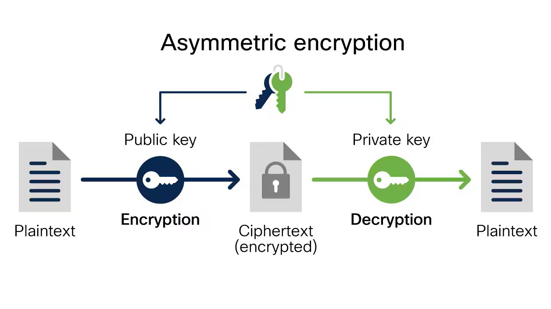
Why Notencrypt?
Notencrypt is an application that uses encryption to protect user data. With a multi-layer encryption mechanism that includes the widely used SHA-512 algorithm combined with different secure algorithms, Notencrypt ensures that all data entered into the application is secure and protected from unauthorized access. The application provides a number of features, including encrypted notes, reminders, voice authentication, and the ability to store encrypted messages and audio files for users. Notencrypt is designed to be user-friendly, with a simple and intuitive interface that allows users to easily navigate the application.
This prevents attackers or anyone with unauthorized access from intercepting and reading sensitive data, protecting user privacy.
Security: Encryption helps prevent data breaches, whether the data is in transit or at rest.

Slide 7
Business Model
From a business standpoint, it will become possible to delegate the execution of an encryption algorithm within an application software while retaining the confidentiality of the data.
This can be a major game-changer for the industry and change the cloud industry.

Slide 8
Market Size
The Encryption Software Market size exceeded USD 6 billion in 2019 and is estimated to grow at over 15% CAGR between 2020 and 2026. Enterprises are looking for increasing their data security by implementing encryption technologies over cloud platforms and mobile devices.
The factor contributing to the encryption software market growth is the rising concern over securing enterprise IP assets Key vendors are developing new solutions to address the protection of IP rights, proliferating the industry revenue However, complexities in encryption key management, easily available pirated & open-source solutions, and stiff regulations on the import and sales may hinder the demand.

Slide 9
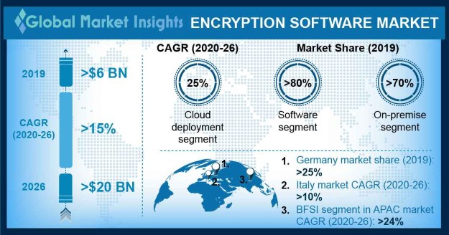

Slide 10
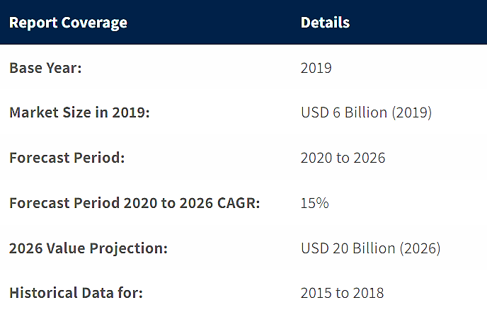
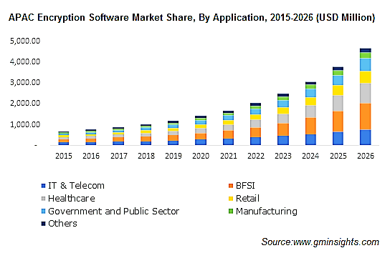
Industry Trends

Slide 11
The software segment accounted for the majority of the market with around 80% share in 2019 and is expected to maintain its dominance through 2026 Rising usage for securing enterprise IP and mitigating financial risks associated with loss or theft of confidential data is likely to boost the segment growth Encryption software emerged as a viable solution for ensuring compliance with data privacy regulations.
Growth Drivers:
Stringent regulations on cybersecurity and data privacy compliances.
Rising concerns over securing enterprise Intellectual Property (IP) assets.
The increasing proliferation of cloud and virtualization technologies.
The growing trend of Bring Your Own Devices (BYOD) among enterprises

Slide 12
Revenue Model
Freemium Model: The basic version of the software can be offered for free, while advanced features, such as higher levels of encryption, cloud backup, and multi-device sync, can be offered for a subscription fee.
Subscription Service: Later the software can be offered as a subscription service, where users pay a monthly or annual fee to access the software's features, including encryption, password protection, and secure syncing.
One-time Purchase: The software can be offered for a one-time purchase fee, which would include all the features, including encryption, password protection, and syncing.
In-App Advertising: The app can be offered for free with advertisements, which would generate revenue for the software developer.
Enterprise Service: The app can be offered to businesses and organizations as a secure note-taking and collaboration tool, with advanced security features such as encryption and multi-factor authentication. The revenue would be generated through licensing fees and/or subscription fees.

Slide 13
"Your notes, your privacy - keep them safe with us”
- Notencrypt

Slide 14
Thank you
Boby Dubey
Devesh Kumar
Utkarsh Kumar
dubeyboby0593@gmail.com

